Slide 1
C Programming
Files

Slide 2
File:
A file represents a sequence of bytes, does not matter if it is a text file or binary file.
C programming language provides access on high level functions as well as low level (OS level) calls to handle file on your storage devices. T

Slide 3
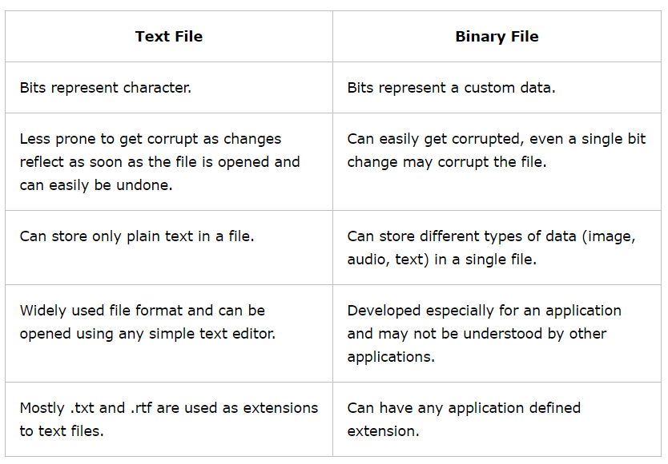

Slide 4
Opening Files:
You can use the fopen( ) function to create a new file or to open an existing file, this call will initialize an object of the type FILE, which contains all the information necessary to control the stream.
Syntax:
Here, filename is string literal, which you will use to name your file

Slide 5
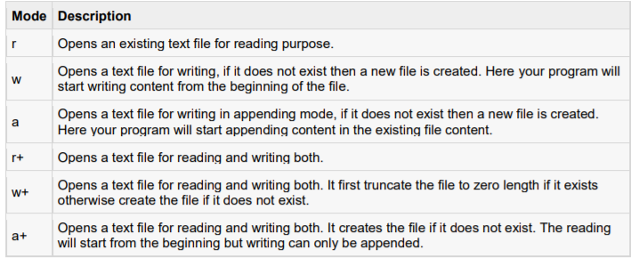
Access mode can have one of the following values:

Slide 6
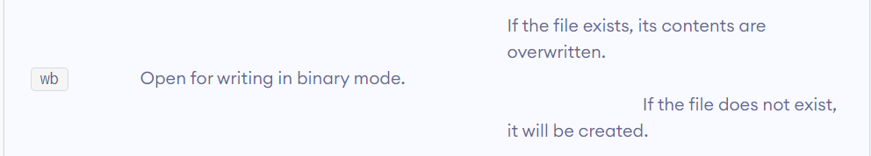

Handling binary files then you will use below mentioned access modes

Slide 7
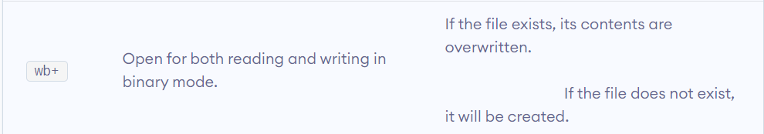

Slide 8
Closing a file
To close a file, use the fclose( ) function. The prototype of this function is:
Syntax:
The fclose( ) function returns zero on success, or EOF if there is an error in closing the file.
This function actually, flushes any data still pending in the buffer to the file, closes the file, and releases any memory used for the file. The EOF is a constant defined in the header file stdio.h.

Slide 9
Writing a file
Following is the simplest function to write individual characters to a stream:
The function fputc() writes the character value of the argument c to the output stream referenced by fp. It returns the written character written on success otherwise EOF if there is an error.

Slide 10
You can use the following functions to write a null-terminated string to a stream:
The function fputs() writes the string s to the output stream referenced by fp. It returns a non-negative value on success, otherwise EOF is returned in case of any error. You can use int fprintf(FILE *fp,const char *format, ...) function as well to write a string into a file.

Slide 11
Reading File
Following is the simplest function to read a single character from a file:
The fgetc() function reads a character from the input file referenced by fp. The return value is the character read, or in case of any error it returns EOF.

Slide 12
The following functions allow you to read a string from a stream:
The functions fgets() reads up to n - 1 characters from the input stream referenced by fp. It copies the read string into the buffer buf, appending a null character to terminate the string.
If this function encounters a newline character '\n' or the end of the file EOF before they have read the maximum number of characters, then it returns only the characters read up to that point including new line character.
You can also use int fscanf(FILE *fp, const char *format, ...) function to read strings from a file but it stops reading after the first space character encounters.

Slide 13
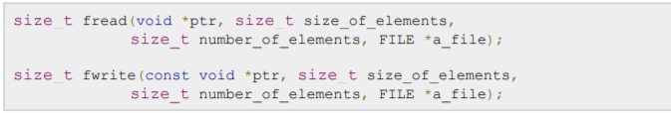
Binary I/O Functions
There are following two functions, which can be used for binary input and output:
Both of these functions should be used to read or write blocks of memories - usually arrays or structures.

Slide 14
Getting data using fseek()
If you have many records inside a file and need to access a record at a specific position, you need to loop through all the records before it to get the record.
This will waste a lot of memory and operation time. An easier way to get to the required data can be achieved using fseek().
As the name suggests, fseek() seeks the cursor to the given record in the file.

Slide 15
